Slide 1
Iot framework with Intel® and AWS*
Martin Kronberg – Technical Evangelist
*Other names and brands may be claimed as the property of others.

Slide 2
The next 2.5 hours:
Overview of Intel IoT Technology
Overview of Intel IoT Dev Program
Overview of AWS IoT
Secure Deployment with Intel
Hands On with Intel and AWS – Edge to Cloud Framework
While we are presenting:
Create an AWS account: aws.amazon.com
Download Workshop Content: http://bit.ly/intel-aws-workshop-reinvent

Slide 3
Intel IOT technology
Notes:
Before I get into the details of how these systems work and how we can use them together I want to give you guys an overview of both Intel and AWS – the Edge and the Cloud.
First Intel – the hardware at the edge- what is their place in the IoT ecosystem?

Slide 4



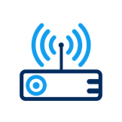



Intel® Architecture Powers Endpoints, Gateways, Networks, and Cloud
NETWORK
(DATA CENTER)
THINGS (ENDPOINTS)
GATEWAY
CLOUD-BASED ANALYTICS
The Intel® IoT Platform: A blueprint for connecting devices into the cloud for developers to better leverage data, customize, and scale
4
Notes:
Overview of Intel IoT Architecture:
- Start: Things – Sensors, Actuators – webcams, temperature, light, servos, etc.
- Finish: Cloud Based Analytics – Deep Learning, Predictive Maintenance, Big Data - AWS
- Well technically the finish is deciding what actions to take from the analytics, but Intel can’t help you there.
- How do we get from start to end? Intel Gateways and AWS servers.
- Things need a way to talk to the data center. They often don’t have a built in internet connection. They use serial protocols like modbus, I2C, short range radios like bluetooth, zigbee, zwave. By connecting over those protocols to a gateway the things have a way of communicating to the data center.
By acting like a central data hub the gateway can also accomplish a few other important functions. Even if the things could communicate to the internet on their own, that’s not a schema that you would want to use. Dealing with that number of individual connections is going to be pretty inefficient and really insecure. More connections is going to means larger surface area for any kind of malicious attacks. So minimizing the number of connections is going to go a long way to help your iot deployment be more secure.
This gateway will also be handling all of the edge compute that we need to do when we want to run local computer vision analysis.

Slide 5
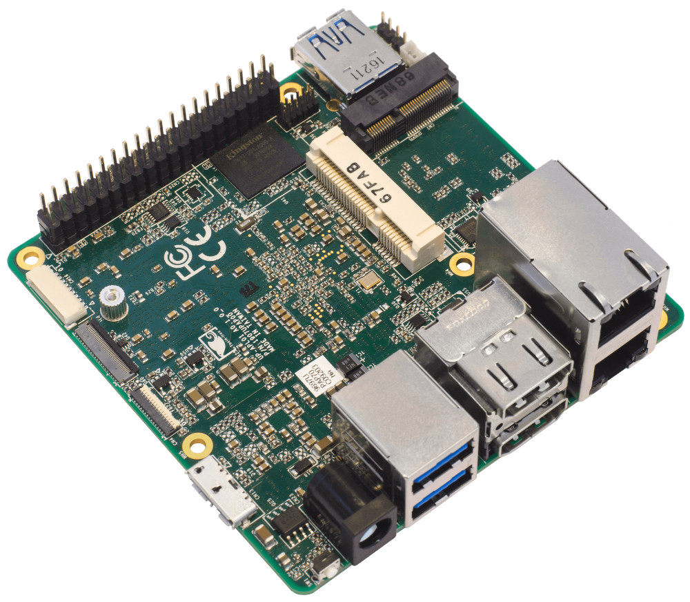
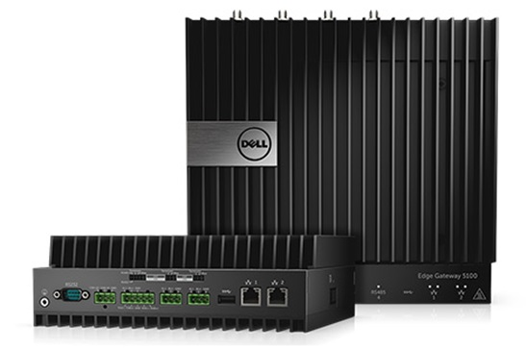
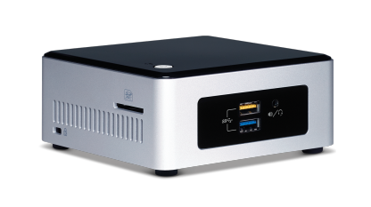
Intel® Gateways
Scalable
Open Source
Wide Range of Specifications
Notes:
Specifically when I talk about Intel Gateways I am referring to the NUC Gateway. A NUC is a ”Next Unit of Computing” a term coined by intel to which refer to a series of small, customizable PCs which come in a wide range of specifications. The specifications range from lightweight prototype devices meant for a simple smart home system, all the way up to a hardened commercial grade device with industrial I/O running on the latest generation i7.

Slide 6
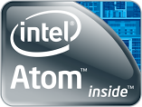
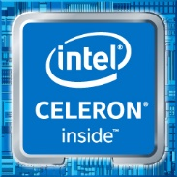
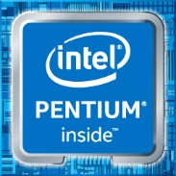
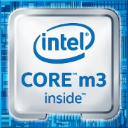
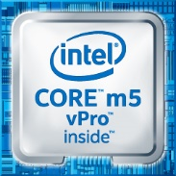

Scalable Processing
From Intel® Atom® to Intel® Core™ i7
Get just the right amount of compute power at the edge
Notes:
Just the right amount of compute power – find a balance between power requirements, heat, cost.
Since all of the processors use the same x86-64 architecture you can shift from one platform to another without having to worry about architecture compatibility.

Slide 7
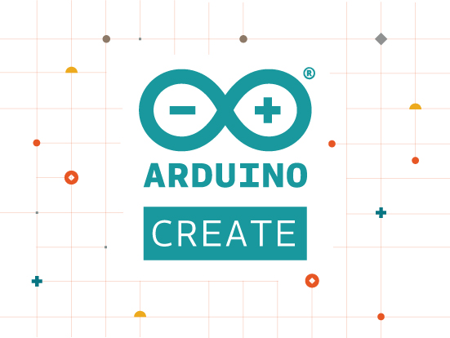
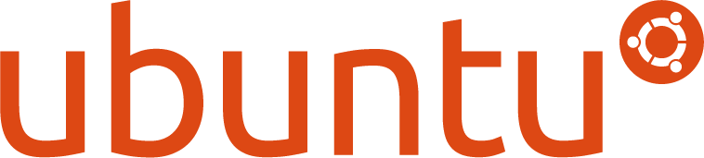
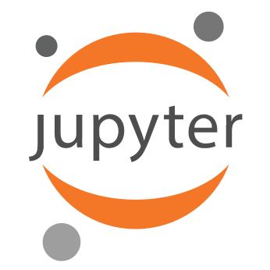
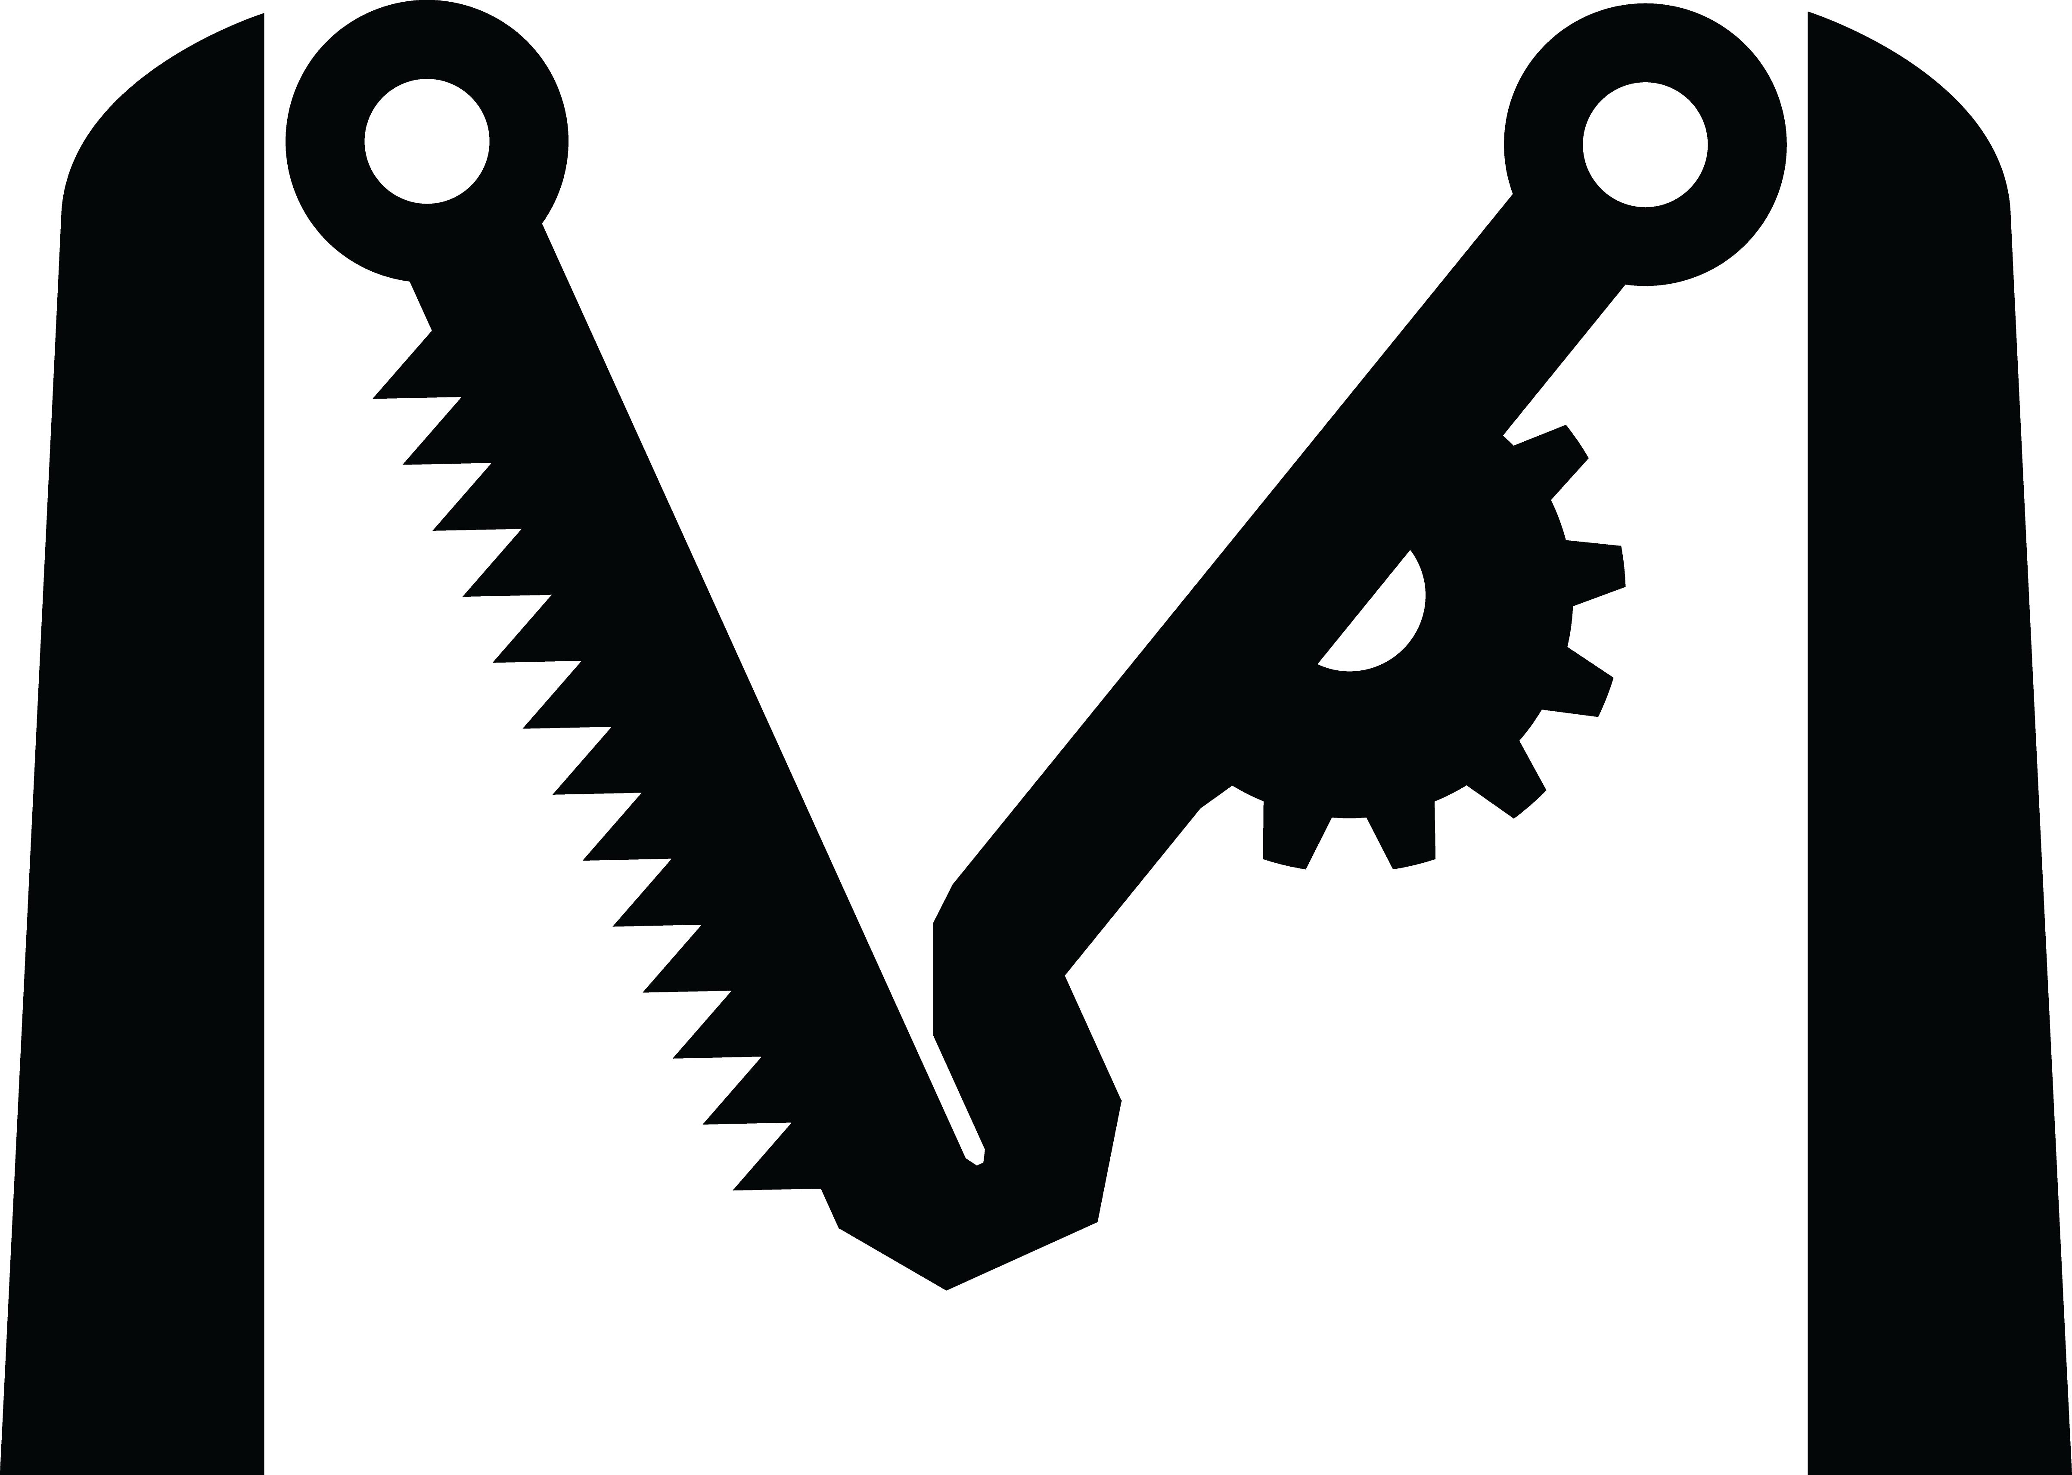


Open Source Technology
MRAA
Notes:
Intel IoT is based on open source technology. All of our libraries, code samples, and operating systems are open source.
For instance the gateway we will be using today is running Ubuntu 16.04. Ubuntu is a familiar OS to anyone that has developed on linux and there is a huge developer community out there that can help you if you get stuck.
We are also going to be using MRAA – an open source sensor library developed and maintained by Intel.
In short having open source technology means that you get better interoperability by working across other open source platforms.
Also as you are developing your project you can pull whatever pieces of code you need from our repositories, use what you need, and not worry about licensing later on.

Slide 8
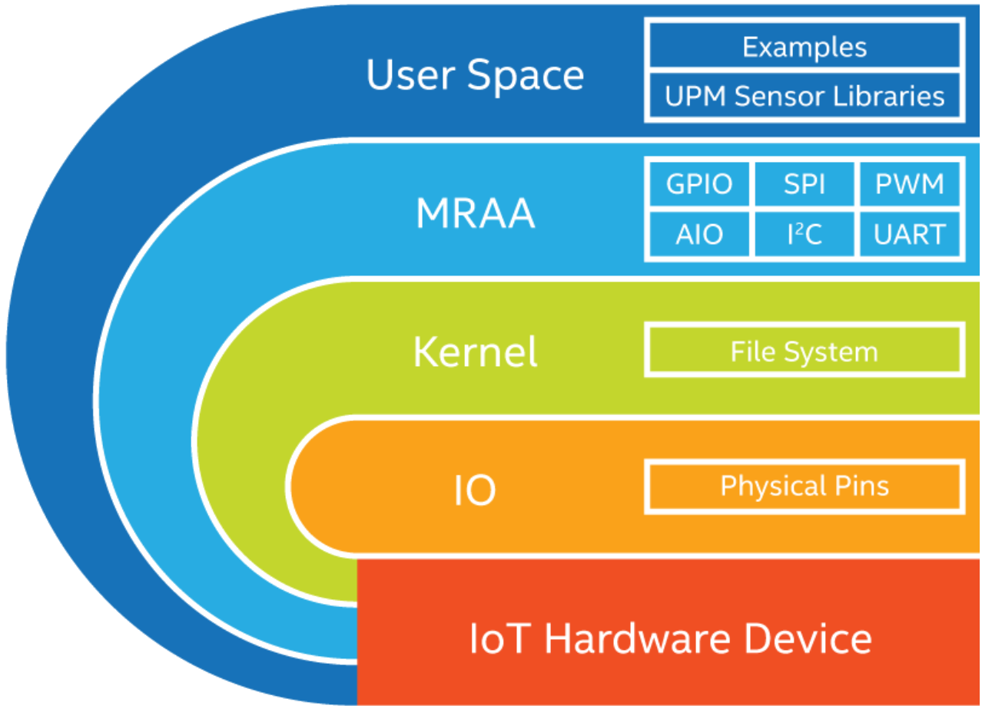
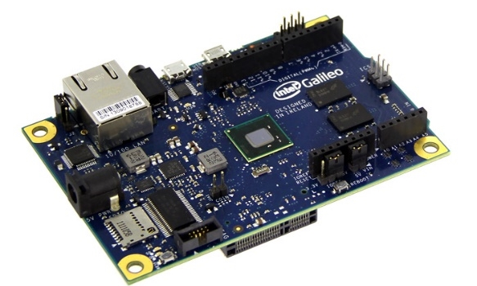
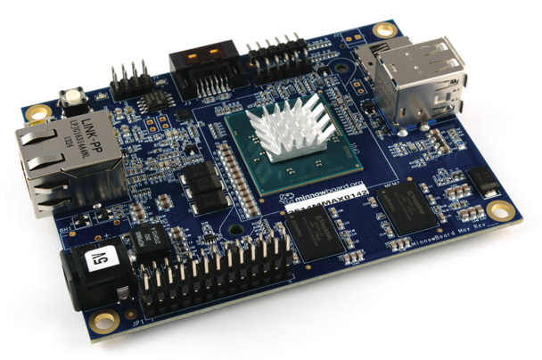
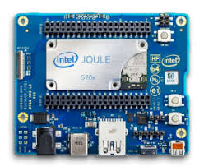
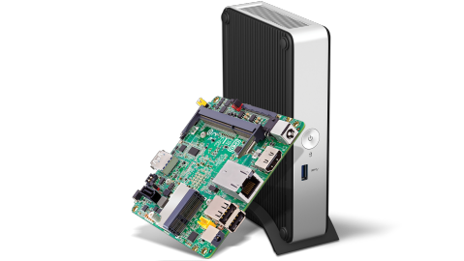
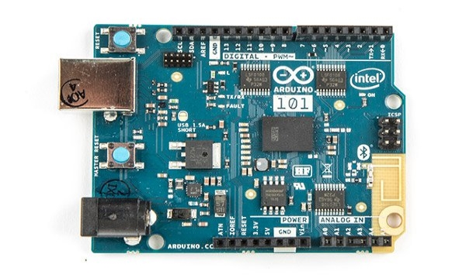
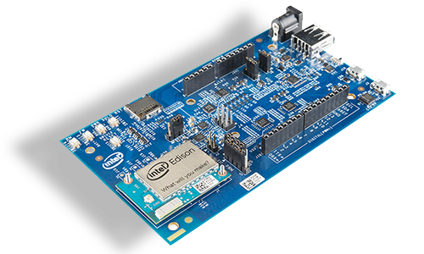
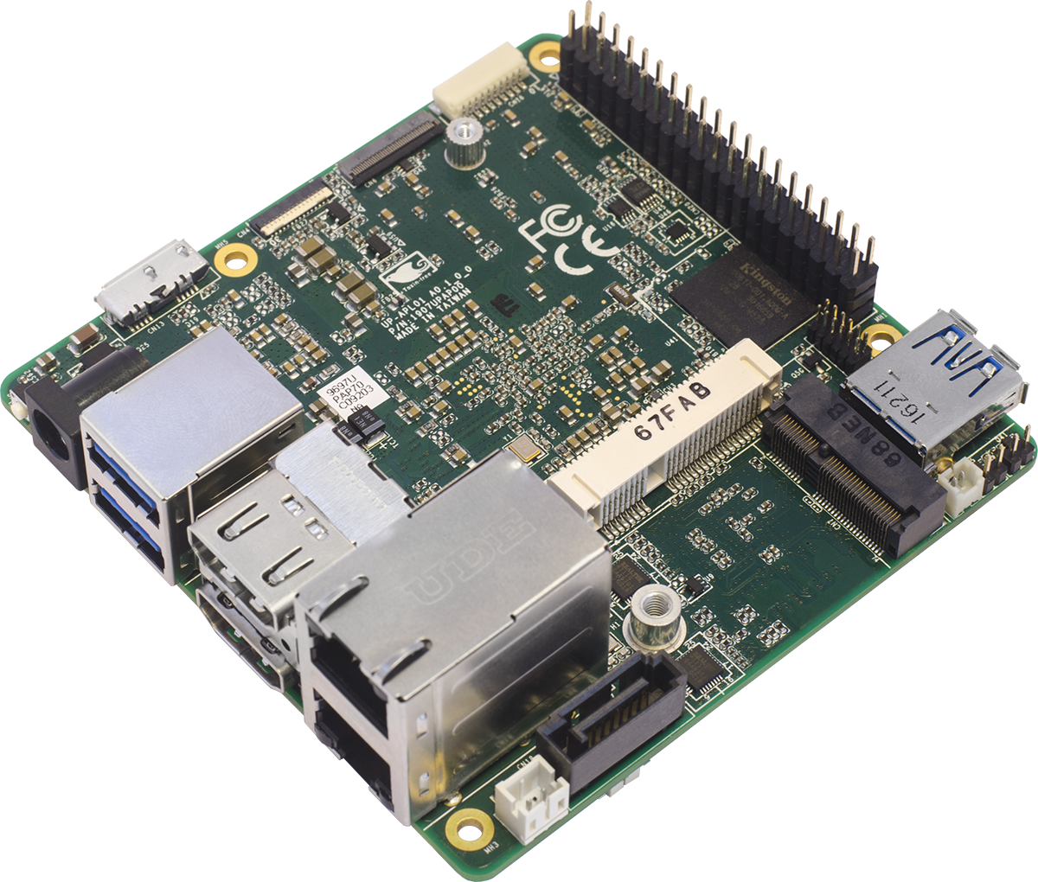
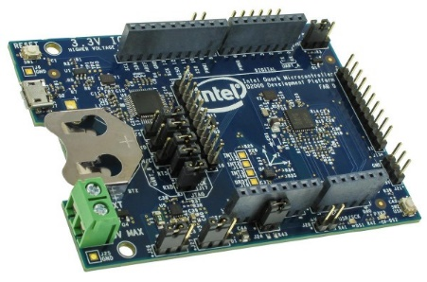
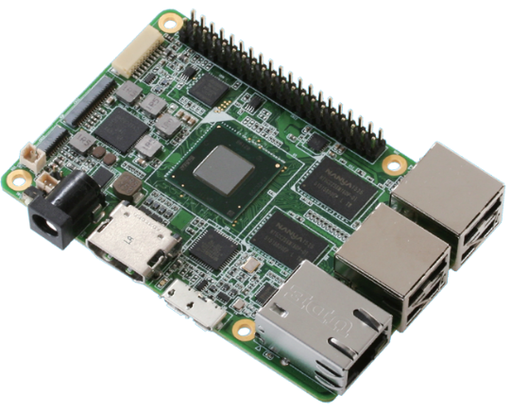

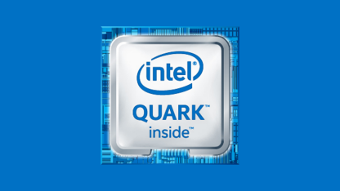
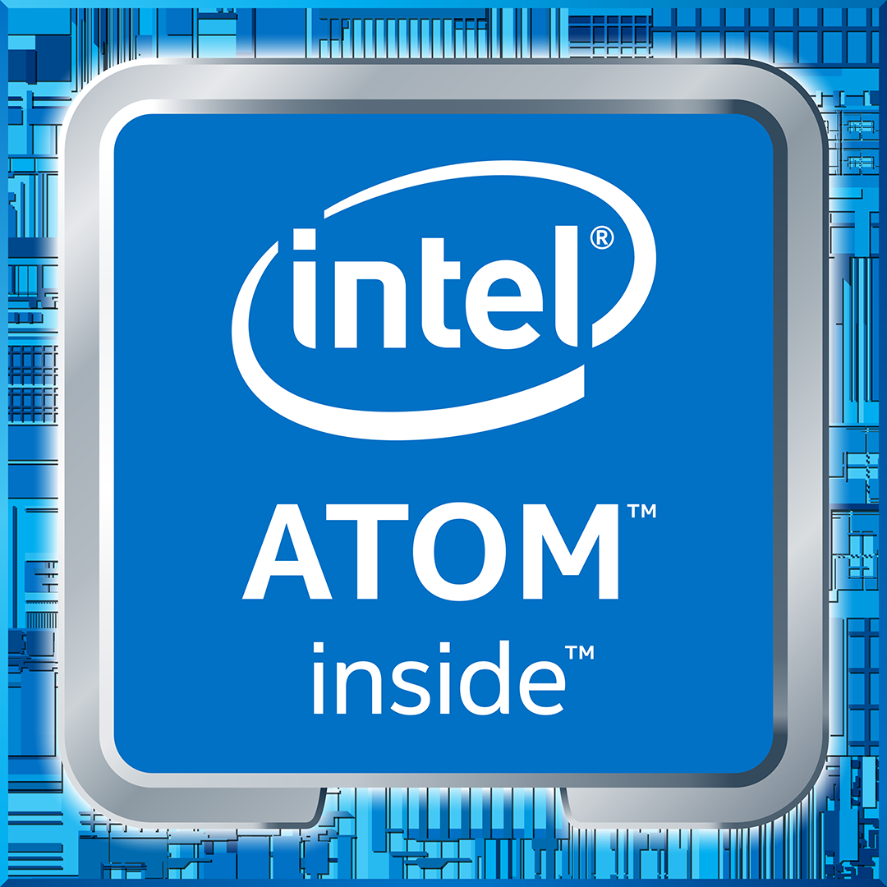
MRAA – I/O Library
Typical stack on UNIX systems:
Supports Intel, non-Intel (community added) MCU boards, UNIX boards and IoT Gateways
Simple I/O protocol control for:
Open source on GitHub:
http://mraa.io
GPIO
Analog (AIO)
PWM
SPI
I²C
UART
1-Wire
Firmata
Notes:
So what is MRAA? Its is a C++ library, with bindings for both Javascipt and Python,
Is used to control low level sensor functionality. This means that you can access GPIOs, read/write to an I2C bus, or interface with a microcontroller board over Firmata amongst other low level interactions.
I also mentioned interoperability earlier. Well you can use MRAA across a huge range of platforms – Intel NUCs, the UP board, Minnowboard, or any other intel microcontroller, MRAA will even work with non intel boards like the rasperry pi, beagalebone, even a DE10-Nano which is an FPGA which runs an Altera cyclone SOC.
So for instance if you are developing a project on one board you can move across to something that fits better – even to a different architecture – and take your low level sensor control code with you.

Slide 9
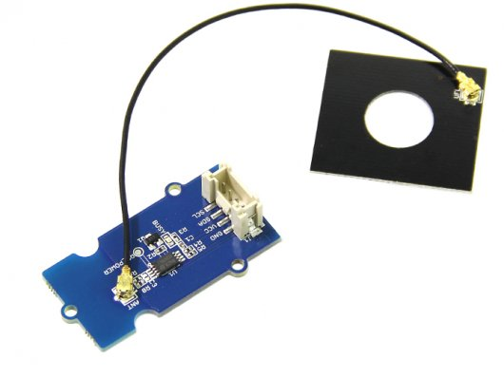
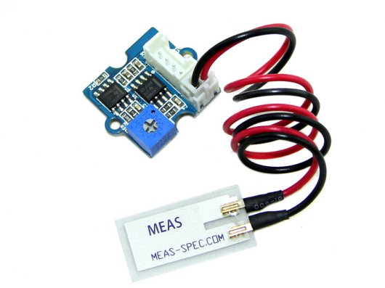
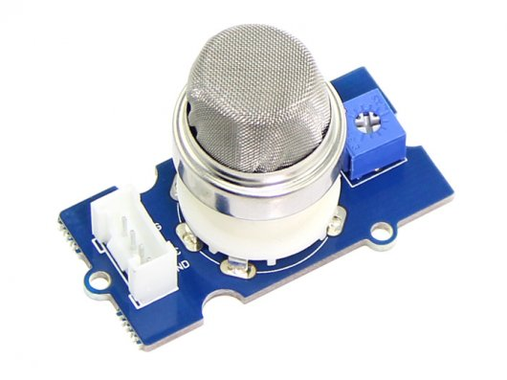
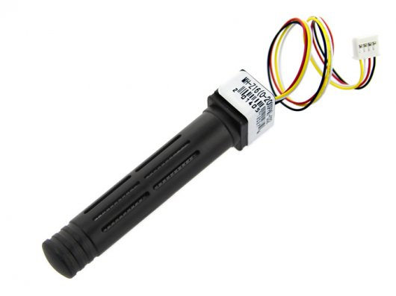
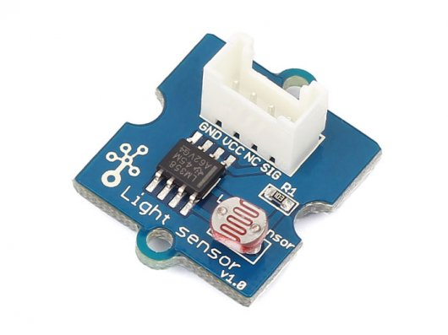
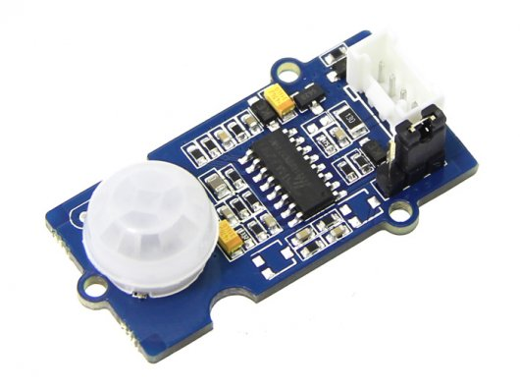
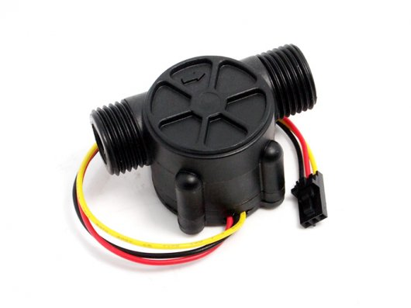
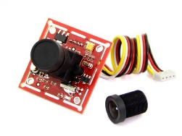
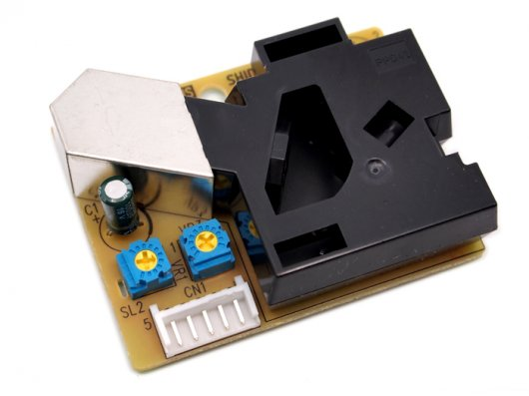
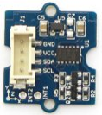
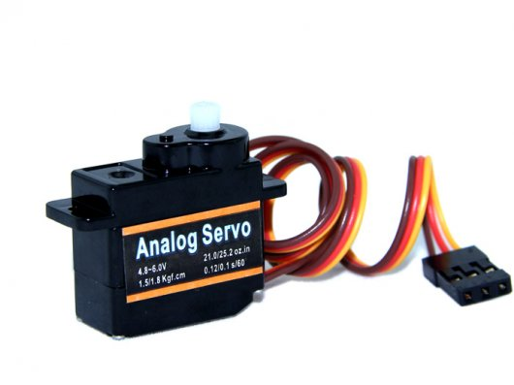
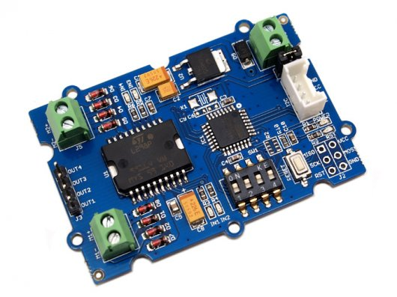
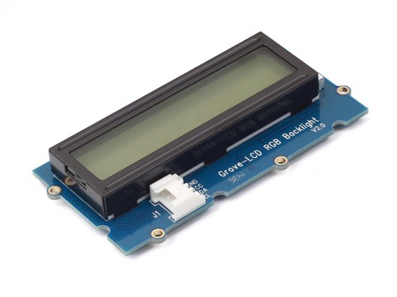
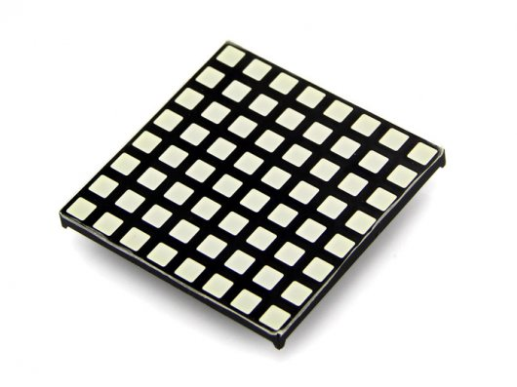
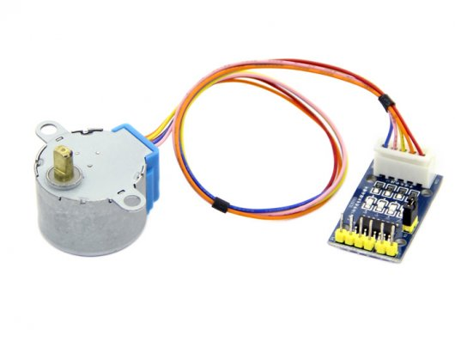
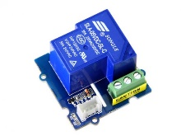
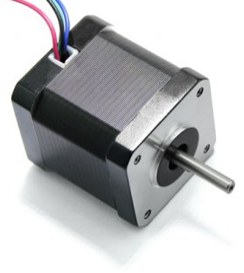
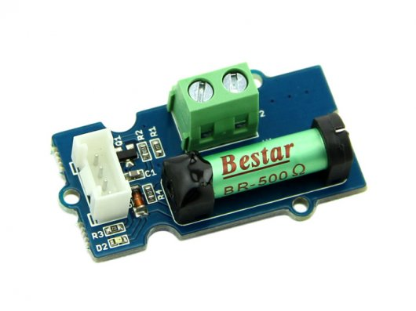
UPM – Sensor Library
Software suite for sensors, actuators, radios and protocols
Open source, Intel maintained, community supported:
http://upm.mraa.io
Sensors
Actuators
Notes:
Now, having these low level libraries is great, but as a developer its nice to have access to high level APIs as well. That’s where UPM – ore the Useful Packages and Modules - library comes in. UPM is built on top of the low level MRAA library and has high level api sensor support for over 300 sensors and actuators. These sensors are things like temperature, moisture, acceleration, magnetic field while actuators cover things like stepper motors, lcd displays, or just simple relays.
The sensors range from simple and inexpensive prototype sensors to more hardened industrial grade sensors. So with UPM you can develop a proof of concept quickly and then when you are ready to move to production you can swap out your prototype sensor with a commercial sensor and keep your same control code.

Slide 10
Intel developer program
Notes:
Before I get into the details of how these systems work and how we can use them together I want to give you guys an overview of both Intel and AWS – the Edge and the Cloud.
First Intel – the hardware at the edge- what is their place in the IoT ecosystem?

Slide 11
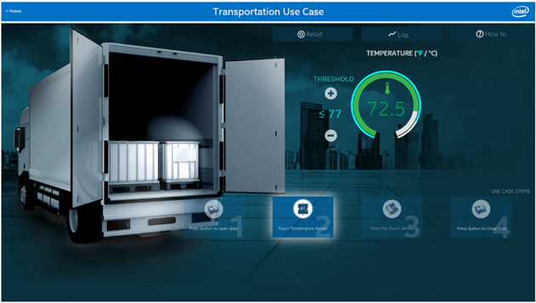
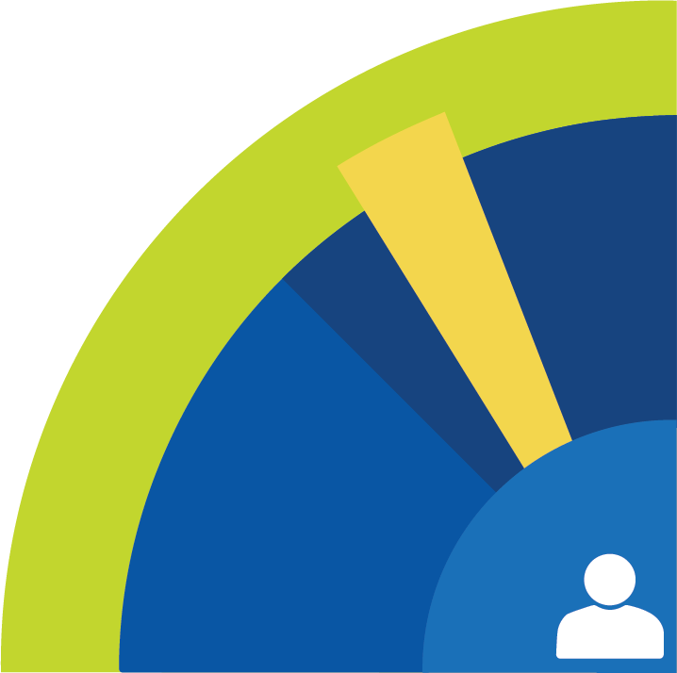
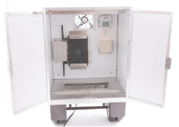
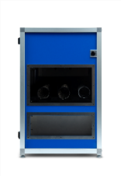



Code Samples
Code
Write your own or reuse sample code & packages for your own projects.
Code snippets
Mini projects
End to end solutions
Transportation, Smart Home, Retail
Code
Notes:
If you want to start developing on the Intel platform you can find a ton of resources to get your project off the ground. There are code samples, proof of concept projects, full IoT solutions with descriptions and code. You can even find market research for certain IoT verticals like smart home, smart transportation, retail and more.
All of the code is open source so you can use whatever portions you want and not have to worry about licensing issues.

Slide 12
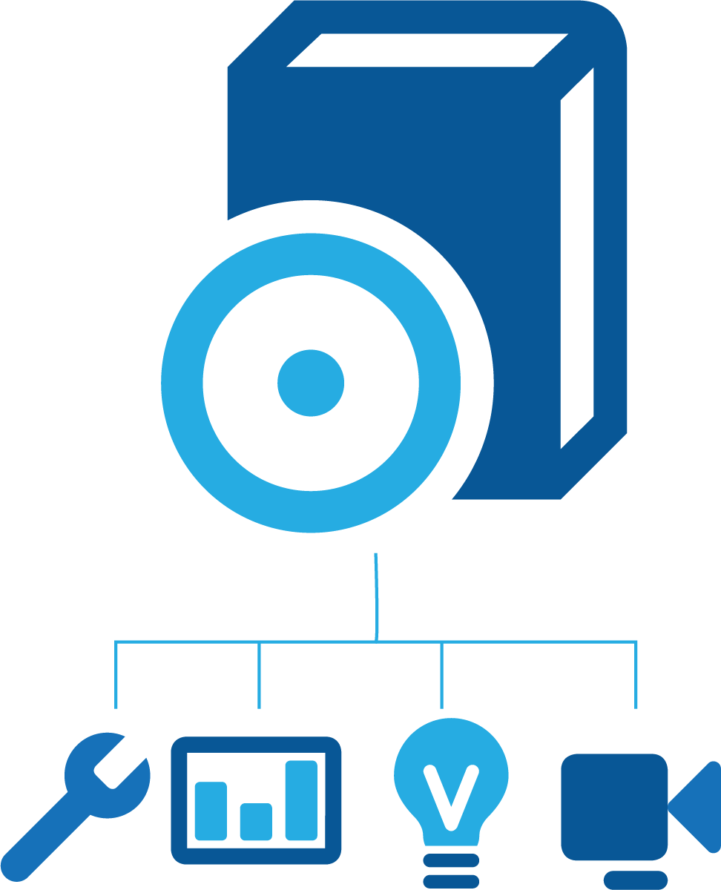

Advanced Edge Compute
Intel® System Studio
Advanced debug, trace, and analysis features help you develop your IoT solutions or embedded applications.
Fully integrated development environment (IDE)
Quickly target and resolve defects in complex systems
Reduce time-to-market for connected devices
SDKs
Computer Vision
Media
Deep Learning
Tools & SDKs

Slide 13
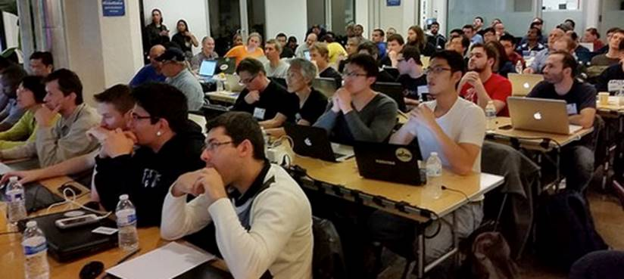
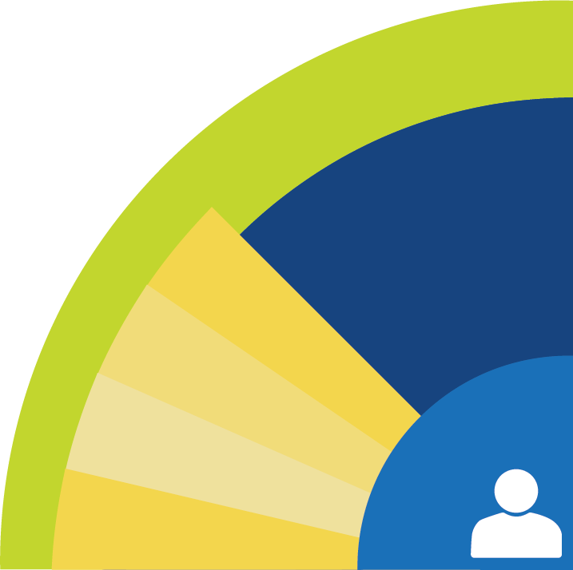
Education Resources
Support throughout the development lifecycle from hands-on to online
Online content Documentation, code samples, live and on-demand tutorial videos
Online communities for learning, building and sharing
Technical Forums for online troubleshooting
Intel® & Industry roadshows, webinars, conferences, hackathons and workshops give hands-on practical experience
Content
Communities
Forums
Events

Slide 14


Developer Kit
Notes:
If you want to start working on a prototype or Proof of concept IoT project a great place to start would be by using the Iot Commercial Developer kit. This kit contains a NUC gateway and a set of Grove sensors. Keep in mind that
You will also need to get an Arduino 101 in order to plug the sensors into.
This kit is great for learning about the Intel IoT ecosystem and starting to build out some projects. The demo we are looking at today was build with this kit.

Slide 15

Intel Developer Program: Software.intel.com/iot
Notes:
So finally how do we tie all this together? Intel has created a hub for IoT developers at software.intel.com/iot. Here you can find all the software, hardware, IDEs, community forums, everything I talked about so far and much more. If you want to learn more about developing IoT with Intel this is a great place to start.

Slide 16
Takeaway:
Hardware
Libraries
IDE
SDK
Open Source
Developer Program

Slide 17
AWS iot
Notes:
Ok so that was an overview of intel IoT, lets do a quick overview of AWS IoT and see how they work together.

Slide 18









AWS IoT
AUTHENTICATION
Secure with mutual authentication and encryption
AWS Services
- - - - -
3P Services
RULES ENGINE
Transform messages based on rules and route to AWS Services
DEVICE SDK
Set of client libraries to connect, authenticate and exchange messages
DEVICE GATEWAY
Communicate with devices via MQTT and HTTP
APPLICATIONS
SHADOW
Persistent thing state during intermittent connections
REGISTRY
Identity and Management of your things
AWS IoT API
Notes:
So AWS – or Amazon Web Services – has become ubiquitous in modern cloud computing. AWS provides compute servers, storage space, and many on demand “Saas” services for developers looking to utilize “serverless computing”
One part of that massive system of services is AWS IoT. AWS IoT is a collection of services that allow the developer to do a number of useful things. First it allows them to connect a device – a NUC gateway for instance – up to AWS and authenticate that connection through SSL certificates my using an MQTT broker. You can also set up a rules engine that takes incoming data from your device and then connects it to any of the other AWS services – so you can store your sensor data in an elastic search database and then access it from another application. Finally there is a services called “thing shadows”. This is a persistent record of the device state which allows any application to read the state of your device, even if the physical connection is lost.
The shadow also helps synchronize communication between your device and AWS, but I want to talk about that in a bit more depth later.

Slide 19
AWS IoT Data
PUBLISH turbines/ev-gen/123 (qos: 0)
{
"timestamp": "2016-11-29T10:00:00",
"temperature": 125,
"humidity": 95,
”rotor-freq": 6455,
“output”: 480,
“output-freq”: 60
}
Notes:
When AWS IoT receives or sends data it does so using MQTT and JSON.
MQTT – or machine query telemetry transport - is a publisher / subscriber communication protocol which is becoming a standard IoT protocol. It essentially relies on a broker – or server – receiving messages from a publisher and then sending messages to any subscribers. It is based around publishing and subscribing to specific topics which are created by simply sending a message to one. This broker exists as an endpoint URL in AWS IoT. It’s a good protocol for IoT because it doesn't’t require a persistent connection like a web socket, so if your device loses internet connection it can just start sending messages again once it reconnects.
JSON- or javascript object notation - is a data format which is easy for humans to read and for machines to parse. It is also becoming a bit of a standard in IoT applications. Here you can see an example of a JSON message sending some sensor data about a turbine.

Slide 20

IoT Overview

Slide 21

Secured through Certificates
Private/Public Key Pair

Slide 22
Iot deployment with SDO

Slide 23


Intel® Secure Device Onboard Enables the IoT to Scale to Billions of Devices
Takes seconds at power on
Provisions dynamically to customer’s IoT platform of choice
Hardware secured-protected onboarding w/privacy
Designed-in, ready for 1-to-many ecosystem enablement
Device Management Platforms
ZERO TOUCH
Place, Power, Provision
Notes:
Key Message: Intel® Secure Device Onboard will help enable the scalability of billions of devices the industry targets for 2020 through secure, automated onboarding in seconds.
Intel embarked on a multi year effort with industry POCs and ecosystem partners to create a vendor-neutral secure onboarding method that would truly scale IOT to billions of connected devices. In this presentation we will look at the this Zero touch onboarding model that is available for production implementations today.

Slide 24


Intel® Secure Device Onboard
TRUSTED IOT ONBOARDING IN SECONDS
The Intel Secure Device Onboard service instantly attests the
device and rendezvous the device to the owners IoT platform
Provider of choice.
Zero-touch
Intel® Secure Device Onboard drives scalability to move POCs to production. Increases devices in use.
Ecosystem wants automated “SIM” like” approach that ties identity to platform initiated activation. No-one is solving.
Notes:
*Intel® Secure Device Onboard (Intel® SDO) is a service that enables a device to be drop-shipped and powered on to dynamically provision to a customer’s IOT platform of choice in seconds. This zero touch model simplifies the installer’s role and scales the number of devices that can securely and automatically deployed in production. Intel® SDO eliminates poor security practices such as shipping default passwords and delivers a break-through device privacy and identity model for IoT. With a single imaging step for zero touch onboarding, device makers can mass produce devices and leave configuration to Intel® SDO
*Target & GTM- for IoT Platform ISVs & CSP marketplaces who’s customers are struggling with siloed & manual device provisioning- we will partner with the Iot platforms that own the end customer relationships to share a small one time onboarding fee.
*1 to many Enablement – use more scalable device enablement method that works for any IoT platform ecosystem. Intel SDO is capable of onboarding to any IOT device management platform. Customer’s will have a broad array of Intel and non-IA devices that need to be provisioned to an IoT Platform. Intel has a rich ecosystem of device partners that have enabled SKUs for the zero touch onboarding method. Intel® SDO s SDKs, enablement APIs, and support are freely available to speed onboarding and usage of IoT Platform services.
Customers are gravitating to this model as an essential scaling mechanism to go from POC to production deployment volumes where manual onboarding has a prohibitive cost.

Slide 25

Intel® Secure Device Onboard (SDO)
http://intel.ly/2zBtATb
Expo Demo
Intel Booth
928
AWS Console
AWS: IoT, Greengrass
AWS Security Credentials
Setup Script
Robot Arm & Vibration Sensor
MQTT/TLS
Intel® SDO Owner & Provisioning Servers
SDO Ownership Proxy:
Gives the Owner Server the credentials needed to claim ownership of the IoT Device when it contacts the Intel® SDO Rendezvous Server
AWS S3
Cloud File
Storage
HTTPS
Configuration & Installation Files
IoT Device (Robot Gateway)
Running Amazon* Greengrass
AWS Security Credentials
SDO Transfer Owner Protocol PHASE 2
SDO Transfer Owner Protocol PHASE 0
Setup Script
Intel® SDO Rendezvous Server
SDO Transfer Owner Protocol PHASE 1
Configuration & Installation Files
Configured & Installed
* Other names and brands may be claimed by their owners
Notes:
http://intel.ly/2zBtATb
SDO = Secure Device Onboard
AWS = Amazon Web Services
MQTT = Message Queue Telemetry Transport
TLS = Transport Layer Security
IoT = Internet of Things

